Slide 1
Chinook Project

Slide 2

Agenda
Introduction
Problem Statement
Objectives
Data Overview
Methodology
Analysis
Recommendation
Conclusion

Slide 3


Introduction
As a prominent name in the music industry, Chinook brings entertainment to listeners worldwide. Offering a diverse array of music genres, Chinook connects with audiences through its global network of service points, delivering quality music across the globe

Slide 4

Problem Statement
to analyze music record sales data to gain insights and make recommendations for the company's strategy in the physical music market.

Slide 5
Objectives
Analyze customer behavior across regions.
Understand purchasing trends and churn rates.
Identify top-performing genres, artists, and albums.
Recommend strategies for customer retention and revenue growth.

Slide 6
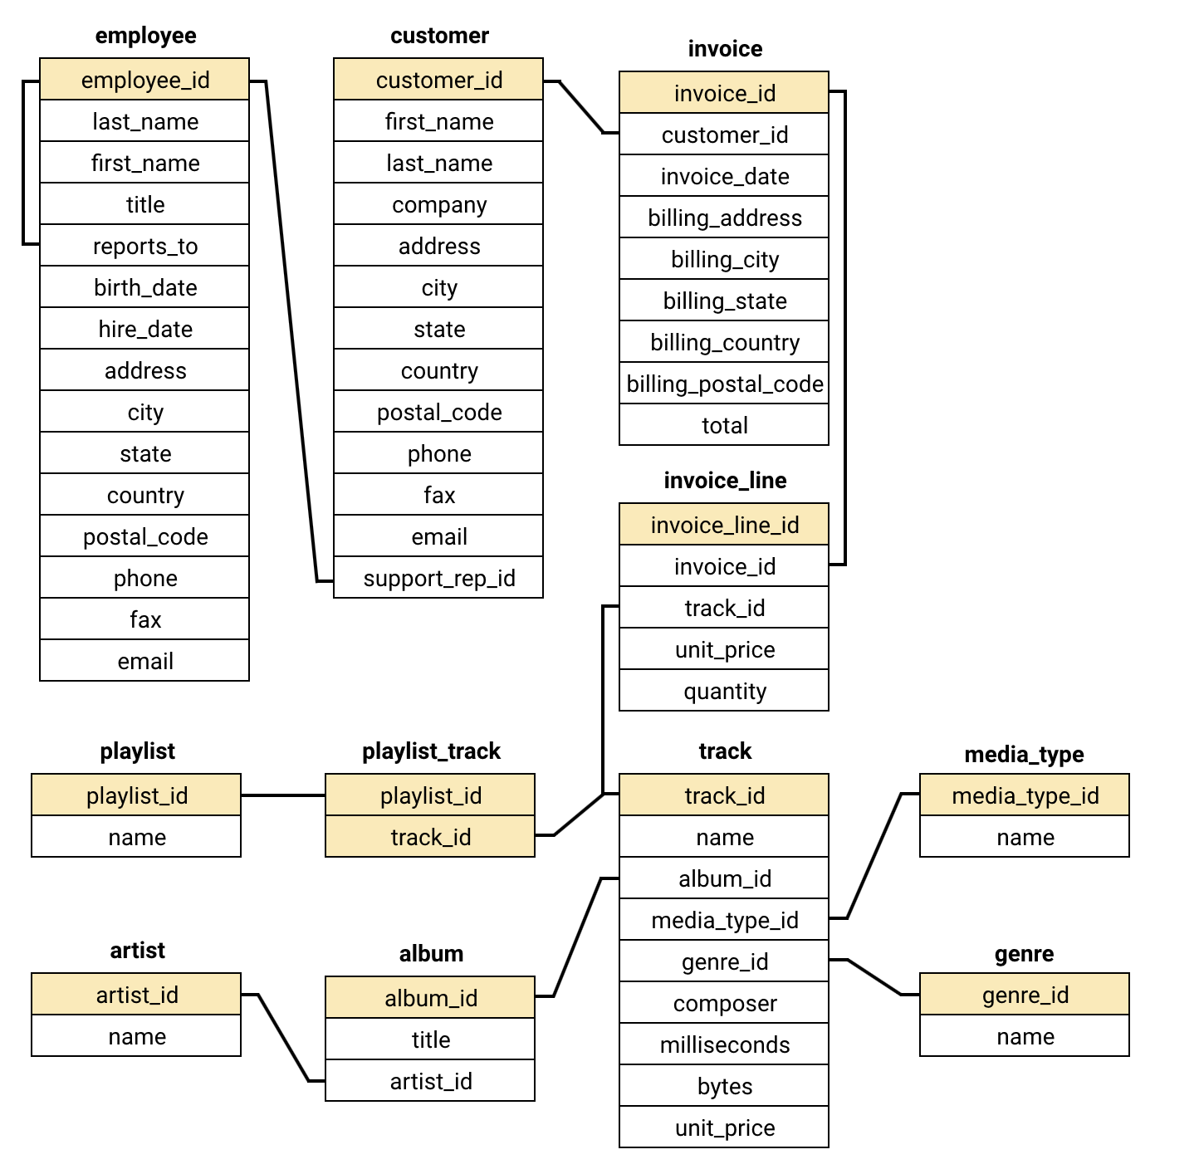
Data Overview
The data provided consists of 11 tables containing information regarding the past performance of Chinook music store
With 251 albums, 130 artists, 25 genres and 59 customers across 24 countries the data is quite vast.
The invoice table contains all the data of transactions by a customer.
Customer table contains the information regarding the customer base of Chinook.

Slide 7

Methodology
Database Schema:
Understood the database structure (tables, relationships), which is
Essential for efficient data navigation
Basic Queries:
Used simple queries to explore the data.Identified key areas for further analysis
Data Cleaning:
Cleaned and prepped data for accuracy,ensured reliable analysis.
Advanced Queries:
Used advanced queries to find hidden patterns (e.g., churn rate, customer segmentation) and gained valuable business insights.

Slide 8
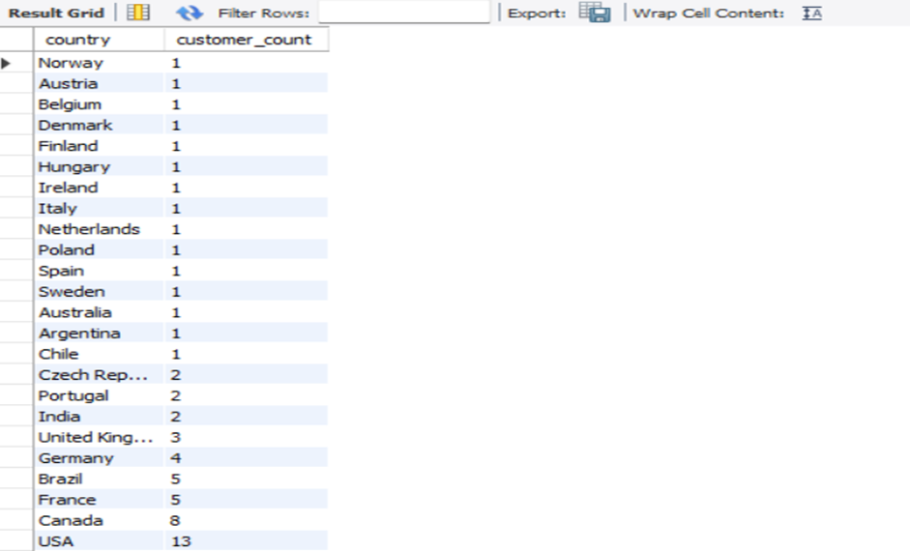
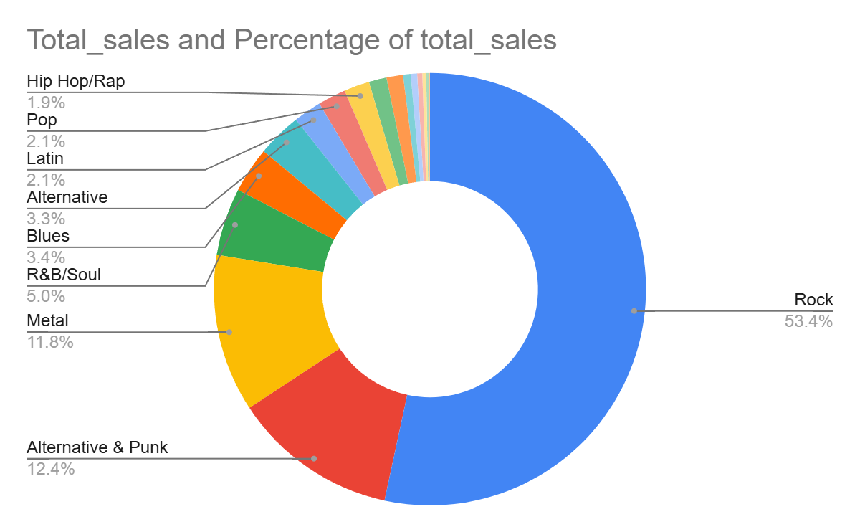
Demographic Analysis
North America: Dominated by USA and Canada, indicating strong customer presence.
Europe: Growing markets in Germany and France, while smaller countries show emerging .
Emerging Regions: Brazil and India stand out in South America and Asia, respectively.
(USA sales percentage)

Slide 9
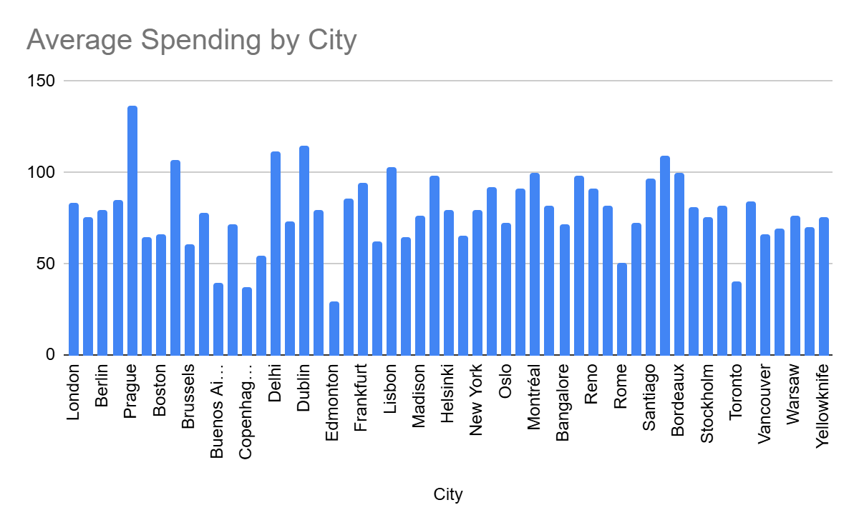
Churn Rate Analysis
Yearly Churn Trend:
2018: 4 customers churned
2019: 5 customers churned
2020: 1 customer churned
Analysis:
The churn data reveals a declining trend in customer attrition over the past few years, with the highest churn rate in 2019 followed by a significant drop in 2020. This could suggest an improvement in customer retention efforts in 2020.

Slide 10
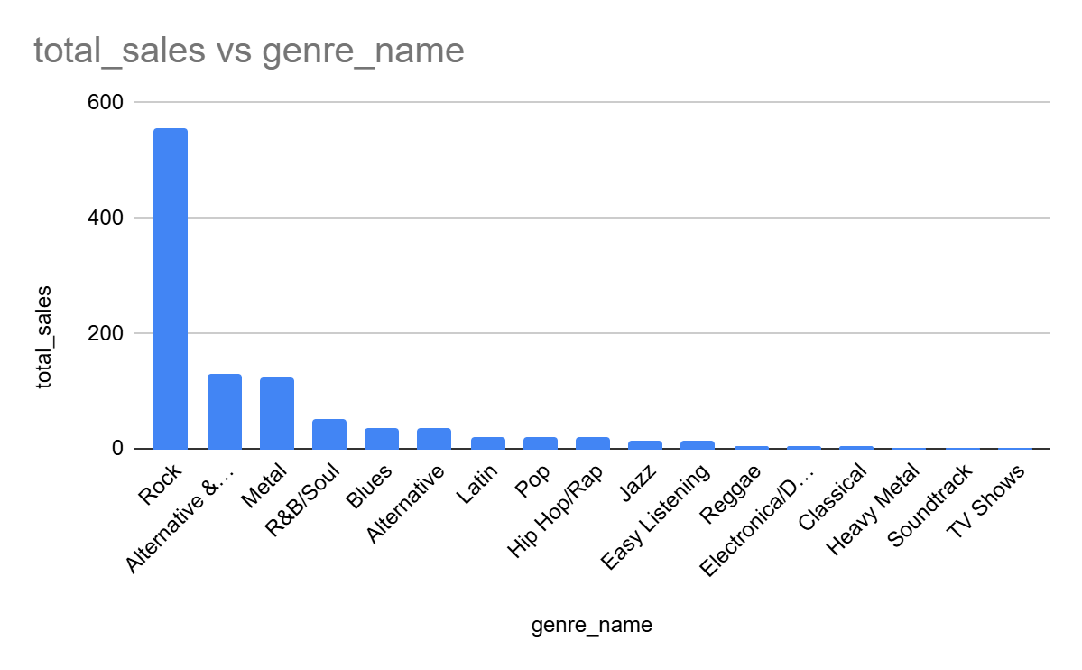
Genre sales analysis
Genre Trends: Rock Leads the Way
Rock continues to dominate, accounting for over 50% of total sales.
Alternative & Punk and Metal genres also exhibit strong sales performance.
Strategic Recommendations:
Focus on stocking and marketing Rock, Alternative & Punk, and Metal genres to cater to high-demand areas.
Roll out genre-targeted promotions to further enhance sales and customer interest in these top-performing categories.

Slide 11

Product Affinity Analysis
Frequently Purchased Together:
If customers who buy Mezmerize (Metal) also often purchase Ace of Spades (Metal), these albums have a strong affinity.
Genre-Based Affinity:
Customers who purchase Dark Side of the Moon (Rock) might also buy The Doors or Are You Experienced? (Rock) due to genre similarities.
Artist-Based Affinity:
A customer buying The Best of The Who could be recommended My Generation - The Very Best of The Who based on their affinity for the artist.
Recommendations:
● Cross-Selling: Suggest albums from the same genre or artist based on what customers have already purchased.
● Personalized Suggestions: Offer complementary albums or artists to increase purchases, e.g., "If you like Mezmerize, check out Ace of Spades."

Slide 12
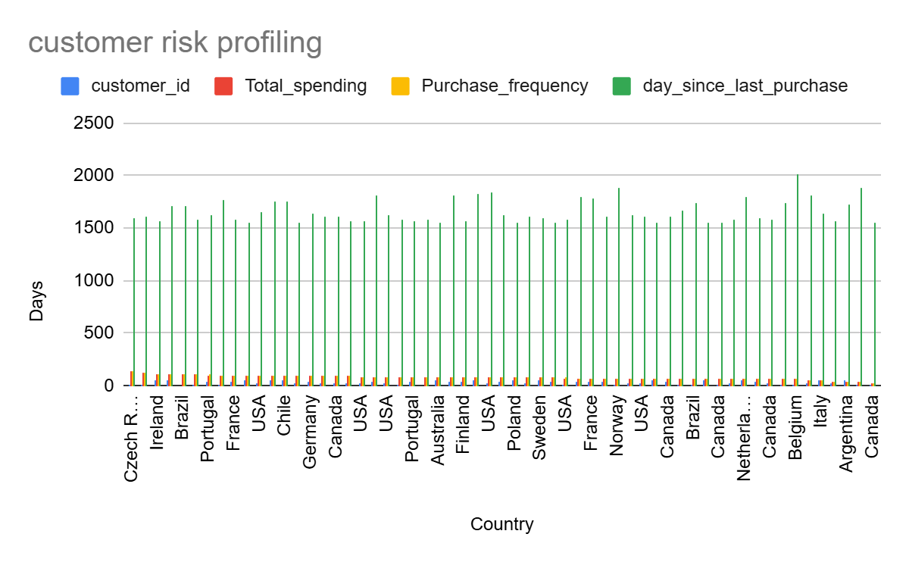
Customer Risk Profiling
Customers Who Have Stopped Purchasing:
● Declining Purchase Frequency: Many customers reduce purchases before stopping completely. E.g., customers with low purchase frequency (like customer 9, with just 37.62 in spending) are at risk.
● Low Spending: Customers with a significant drop in total spending, like customer 14 (spending just $29.70), may signal they’ve stopped purchasing.
● Inactivity: Customers not purchasing recently (e.g., customers like 14 who have been inactive for months) are likely to churn.
● Engagement Drop: Customers with poor engagement, such as those who don’t open emails or engage with promotions, are more likely to stop purchasing.

Slide 13

Recommendations:
Loyalty Programs: Implement loyalty programs to reward long-term customers, especially those with a long tenure but lower recent spending, to retain them and encourage more frequent purchases.
Re-engagement Campaigns: Target inactive customers with personalized offers like discounts and reminders to encourage them to return and make a purchase.
Segmented Offers: Offer exclusive rewards to high-value customers while creating targeted promotions to incentivize lower-value customers to increase their spending.

Slide 14
Recommendations
Implement Loyalty Programs: Establish loyalty programs that reward long-term customers, fostering stronger relationships and encouraging repeat purchases.
Personalized Customer Engagement: Use targeted marketing and personalized recommendations to enhance the customer experience, driving higher engagement and retention.
Enhance Customer Service: Deliver exceptional customer service to build lasting trust and loyalty, ensuring customers feel valued and are more likely to remain loyal.
Prioritize High-Value Customers: Focus on identifying and nurturing long-term, high-value customers, offering them exclusive benefits and personalized experiences to strengthen their loyalty.
Explore New Markets and Localized Strategies: Identify new growth opportunities by targeting emerging markets, and tailor marketing efforts to local preferences through strategic partnerships and localized campaigns.

Slide 15
Conclusion
Enhancing Customer Retention: Implement loyalty programs and personalized marketing strategies to foster stronger connections and retain customers over time.
Maximizing High-Value Customers: Offer exclusive incentives to long-term, high-value customers, reinforcing their loyalty and encouraging continued engagement.
Ensure Data Integrity: Prioritize maintaining accurate and up-to-date data to generate reliable insights that drive informed decision-making.
Tailored Marketing Approaches: Develop region-specific campaigns that cater to local preferences, maximizing the relevance and impact of marketing efforts.
Expand Data Collection: Focus on gathering demographic data to refine customer targeting and deliver more personalized marketing initiatives.
Final Thought: By leveraging these strategies, Chinook can optimize its operations, strengthen customer relationships, and drive sustainable growth, positioning itself for long-term success in an increasingly competitive market.

Slide 16


